Slide 1


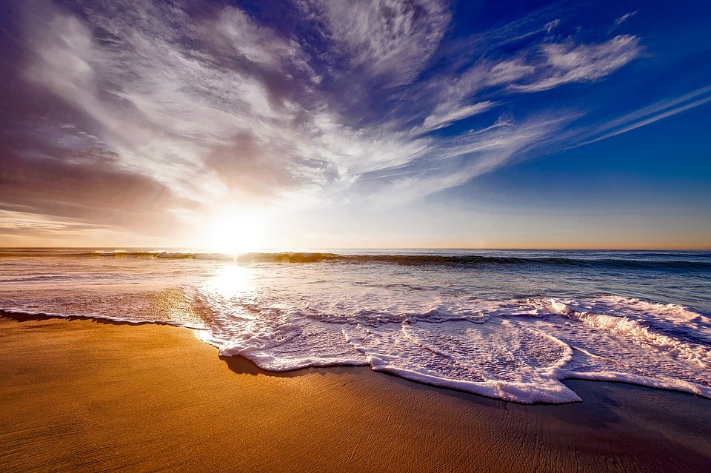
Monthly Meeting (January)
MIC
Smart Beach
CRYdata Solutions:
Cassandra Forlani
Ruwindhu Dilanga Chandraratne Hettige Don
Yi-Chen Hsiao
12019 (2016)
Notes:
Image: 12019 (2016) Ocean waves crashing on shore during daytime https://pixabay.com/photos/beach-sea-sunset-sun-sunlight-1751455/

Slide 2

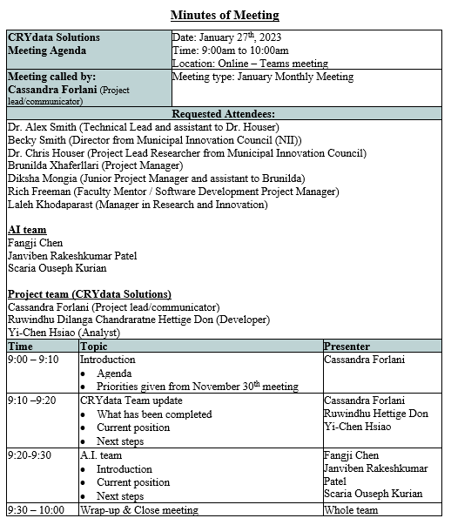
Agenda
Grabowska (n.d.)
Notes:
Grabowska, Karolina (n.d.) Person Writing on a Planner. Accessed on January 26th from https://www.pexels.com/photo/person-writing-on-a-planner-5240040/

Slide 3

What was provided in November
Question 1: Can we predict the inshore significant wave height, wave period, wave direction, current speed, and temperature profile using readily available weather and wave data from NDBC buoys in Lake Huron as well as weather stations managed by Environment Canada and NOAA. Part of this question is balancing the amount of data with the confidence in the prediction.
Data provided: wave, temperature, and current data from the buoy.
Data needed: Weather and wave data from NOAA and Environment Canada.
Question 2: Using the above model, we would like to predict the wave, current and temperature conditions for past drownings and rescues at Kincardine and along the Huron shore of Bruce County.
Data needed: Historical Weather and wave data from NOAA and Environment Canada.
Question 3: Predict the wave conditions and current visible in the camera images, as well as the number and distribution of people on the beach and in the water.
Data provided: anonymized images from the camera. This will be provided later once the images are anonymized, with a focus on providing the model set first.
Focus is on Questions 1 and 2 due to time
Pixie (n.d.)
Notes:
Content Pixie (n.d.) Mug, Watch, and Planner Book on Brown Wooden Surface. Accessed on December 6th, 2022, from https://www.pexels.com/photo/mug-watch-and-planner-book-on-brown-wooden-surface-2736499/

Slide 4
What was provided in November
Question 1: Can we predict the inshore significant wave height, wave period, wave direction, current speed, and temperature profile using readily available weather and wave data from NDBC buoys in Lake Huron as well as weather stations managed by Environment Canada and NOAA. Part of this question is balancing the amount of data with the confidence in the prediction.
Data provided: wave, temperature, and current data from the buoy.
Data needed: Weather and wave data from NOAA and Environment Canada.
Question 2: Using the above model, we would like to predict the wave, current and temperature conditions for past drownings and rescues at Kincardine and along the Huron shore of Bruce County.
Data needed: Historical Weather and wave data from NOAA and Environment Canada.
Question 3: Predict the wave conditions and current visible in the camera images, as well as the number and distribution of people on the beach and in the water.
Data provided: anonymized images from the camera. This will be provided later once the images are anonymized, with a focus on providing the model set first.
Focus is on Questions 1 and 2 due to time
AI team will be focusing on question 3 and will be assisting with question 2 (if time)
Notes:
Content Pixie (n.d.) Mug, Watch, and Planner Book on Brown Wooden Surface. Accessed on December 6th, 2022, from https://www.pexels.com/photo/mug-watch-and-planner-book-on-brown-wooden-surface-2736499/

Slide 5


A.I. Team
Introduction
Kindel Media (n.d.)
Notes:
Kindel Media (n.d.) People Shaking Hands. Accessed on January 25th 2023 from https://www.pexels.com/photo/people-shaking-hands-6773401/

Slide 6

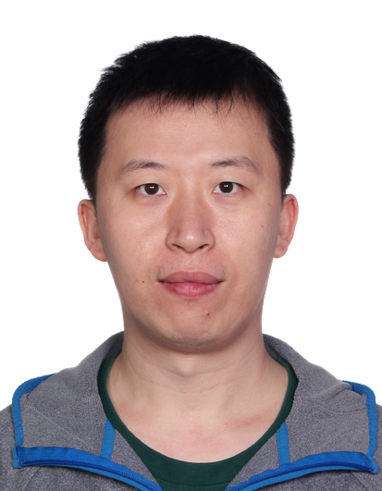
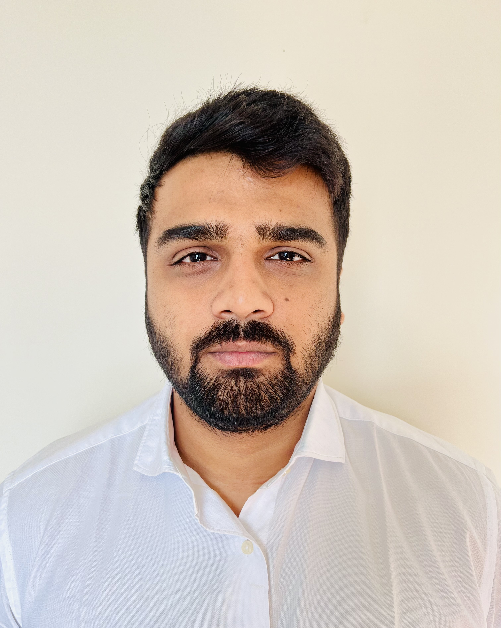
Who we are
I have a Bachelor of Computer Science degree from GTU. Prior to the Big Data Analysis program at Georgian College, I was a software developer. In terms of skills, I have high communication and organization with intermediate level experience in Python, Power BI, Machine Learning, and Deep Learning. I look forward to this project and our future weeks together.
I have a bachelor's degree in electronic information engineering and have 10 years of working experience in software engineering, data mining, and machine learning after graduating. I'm glad to work on this project and move forward with the group.
I have a Bachelor’s degree in computer science and a postgraduate program in Big Data Analytics and now I’m pursuing Artificial intelligence at Georgian college. I have an intermediate level experience in Power BI, Machine Learning, and Python. I’m glad to work on this project and move forward with this group.

Slide 7

Project Update
Fauxels (n.d.)
Notes:
Fauxels (n.d.) People Discuss About Graphs and Rates. Accessed on January 25th from https://www.pexels.com/photo/people-discuss-about-graphs-and-rates-3184292/

Slide 8
Dataset Variables and their definitions
Datasets Time frame: June to October, 2022
Kincardine buoy data (every 20 mins)
49 variables (except date & time)
8,215 records
Standard meteorological data (every 10 mins)
13 variables (except date & time)
21,723 records
Variables
Air_pressure_at_mean_sea_level (Pa)
Air_temperature (K)
Sea_surface_wave_mean_period (s)
Sea_surface_wave_significant_height (m)
Sea_surface_wave_from_direction (degree)
Wind_from_direction (degree)
Wind_speed_of_gust (m s-1)
Wind_speed (m s-1)
Eastward_sea_water_velocity_1 (m s-1)
Northward_sea_water_velocity_1 (m s-1)
Sea_water_temperature_1 (K)
total_water_velocity_1 (computed)
total_water_direction_1 (computed)
Variables
WDIR -Wind direction
WSPD - Wind speed (m/s)
GST - Peak 5 or 8 second gust speed (m/s)
WVHT - Significant wave height (meters)
DPD - Dominant wave period (seconds)
APD - Average wave period (seconds)
MWD - The direction from which the waves at the DPD are coming
PRES - Sea level pressure (hPa)
ATMP - Air temperature (Celsius)
WTMP - Sea surface temperature (Celsius)
DEWP - Dewpoint temperature
VIS - Station visibility (nautical miles)
TIDE - The water level in feet above or below
From
Depth 1-9
Notes:
Image: from free image website - unsplash (https://unsplash.com/)

Slide 9
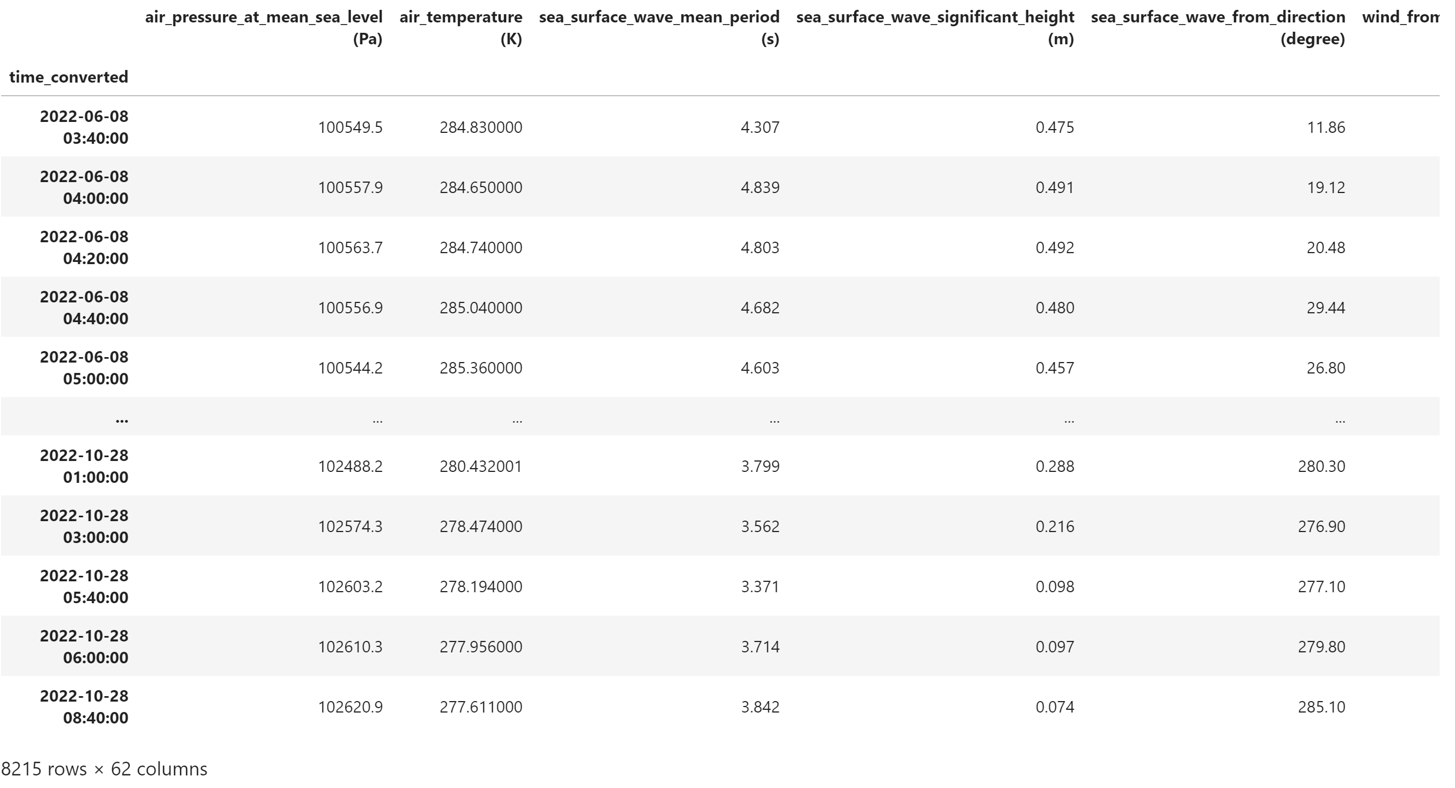
Snapshot of merged dataset
62 variables (except date and time)
8,215 rows occurring every 20 min
Notes:
Image: from free image website - unsplash (https://unsplash.com/)

Slide 10
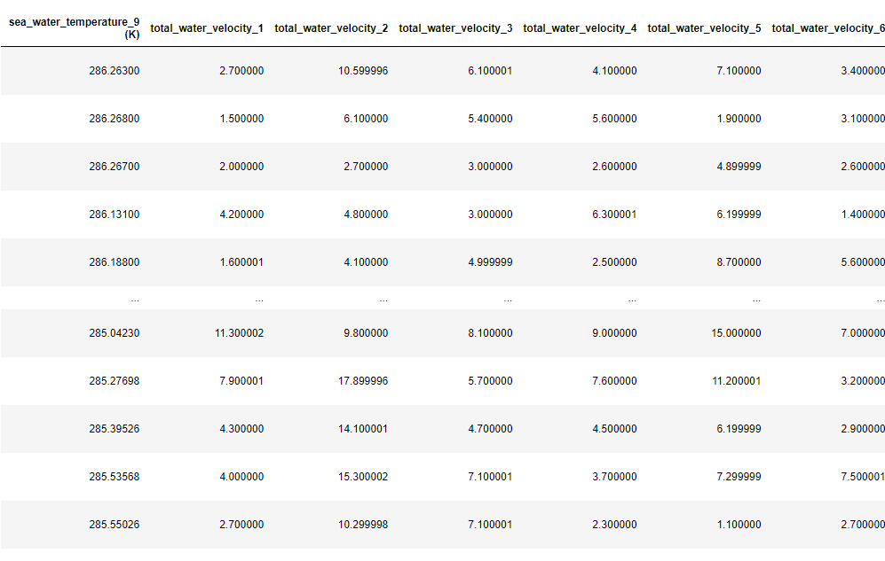
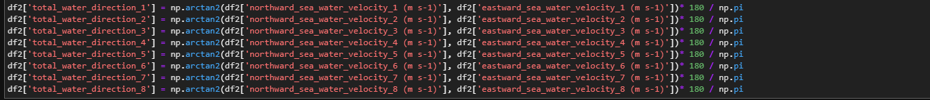
Addition of two calculations
Total velocity
Notes:
Image: from free image website - unsplash (https://unsplash.com/)

Slide 11
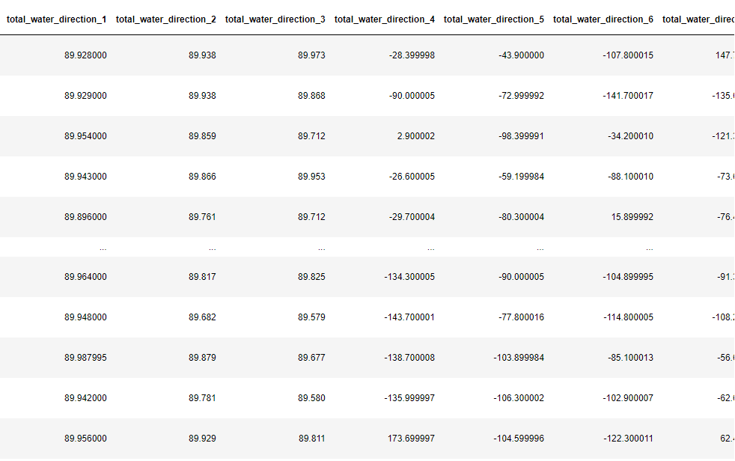
Addition of two calculations
Direction
Notes:
Image: from free image website - unsplash (https://unsplash.com/)

Slide 12
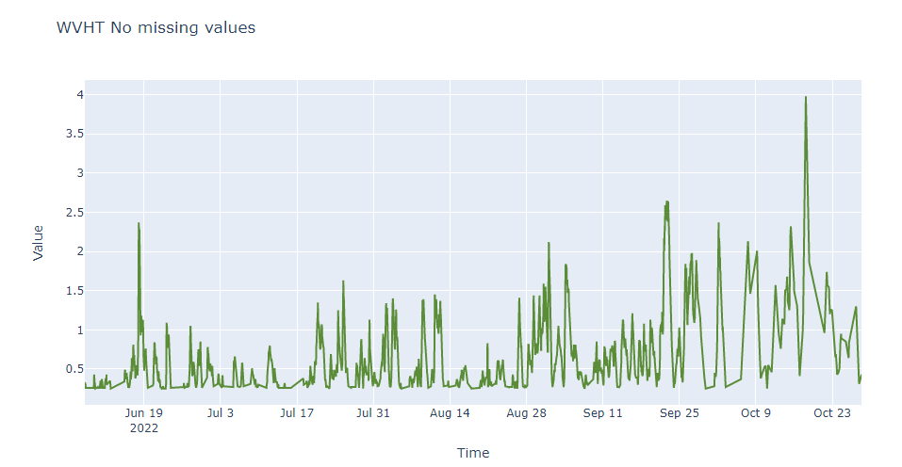
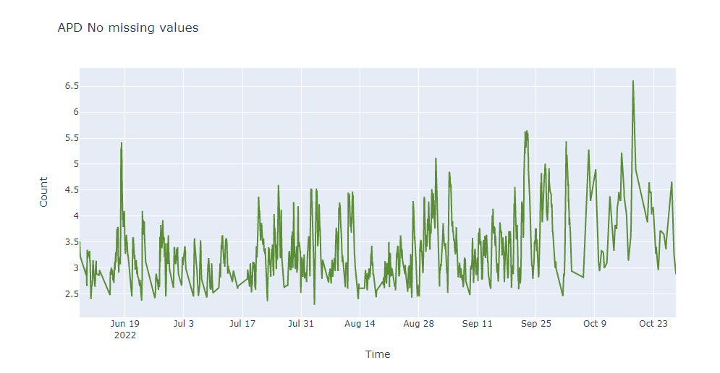
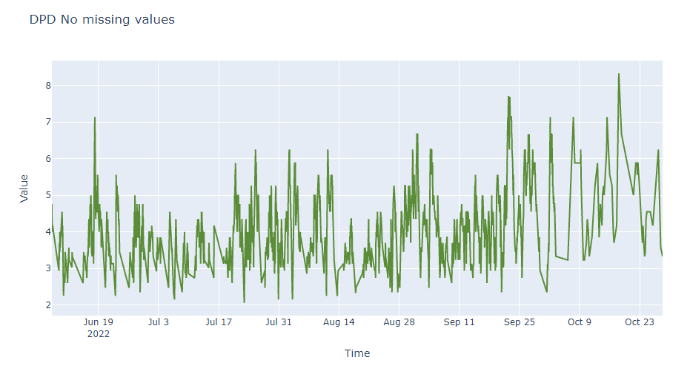
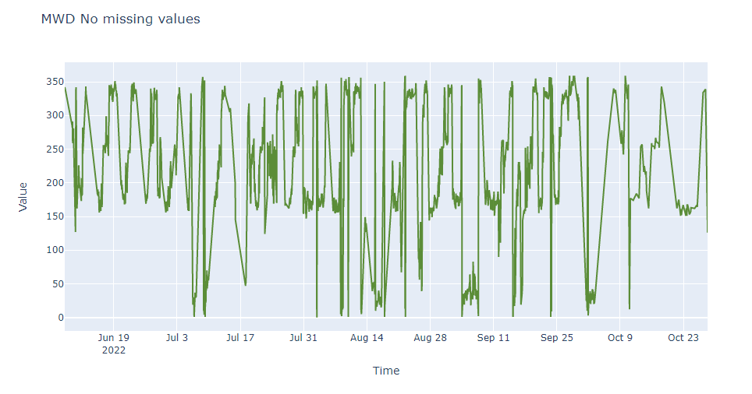
Note: “No missing values” means the entire dataset is cleaned of missing values
Overall Visuals

Slide 13
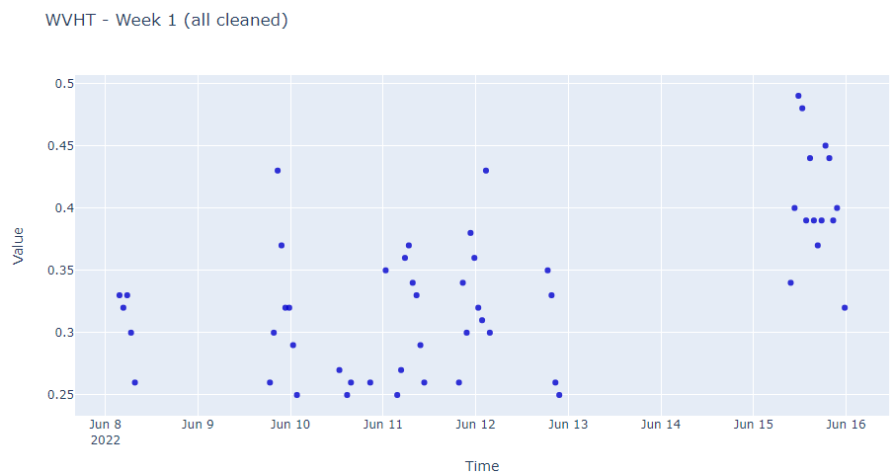
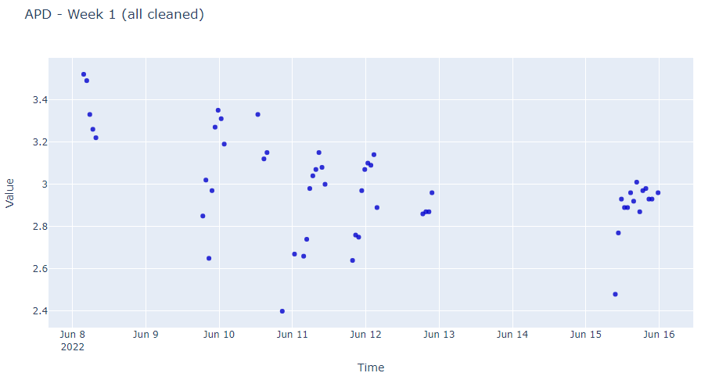
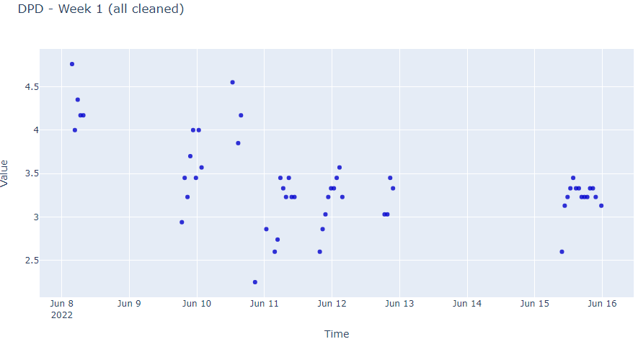
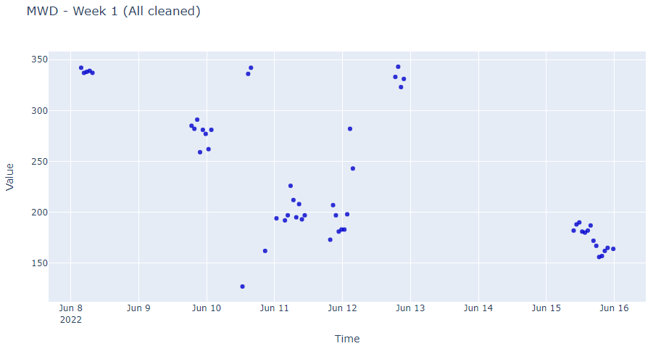
Week 1 Visuals

Slide 14
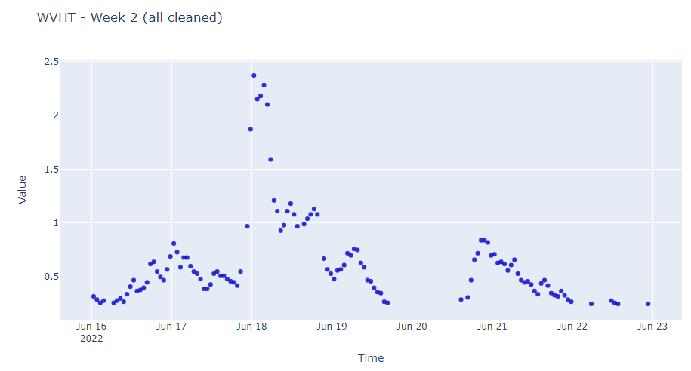
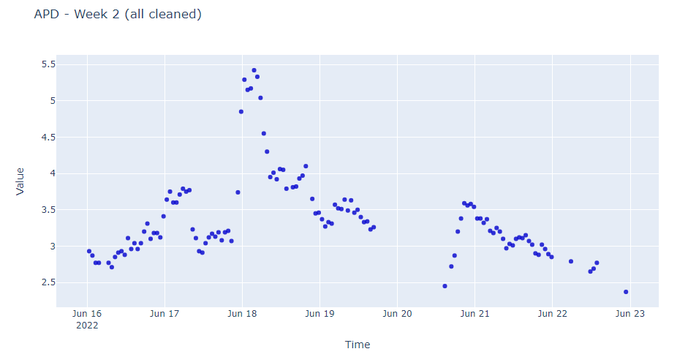
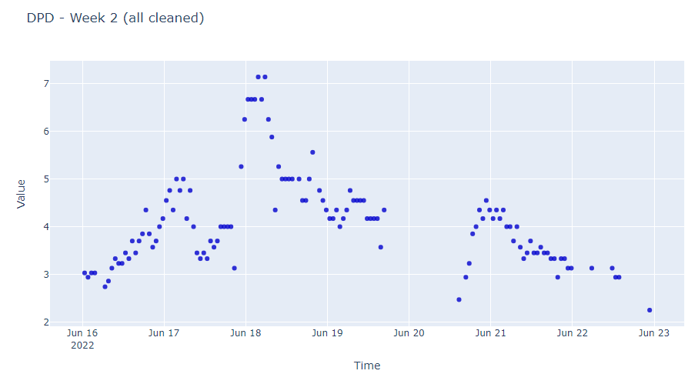
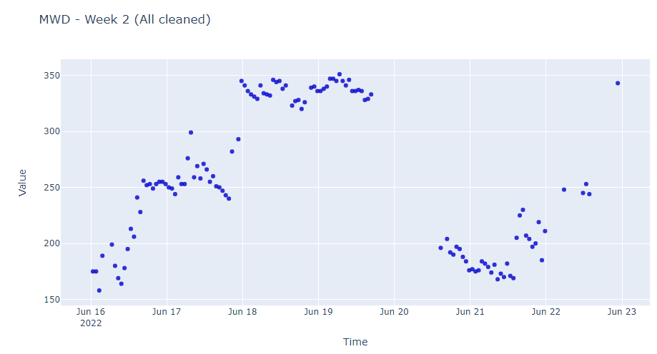
Week 2 Visuals

Slide 15
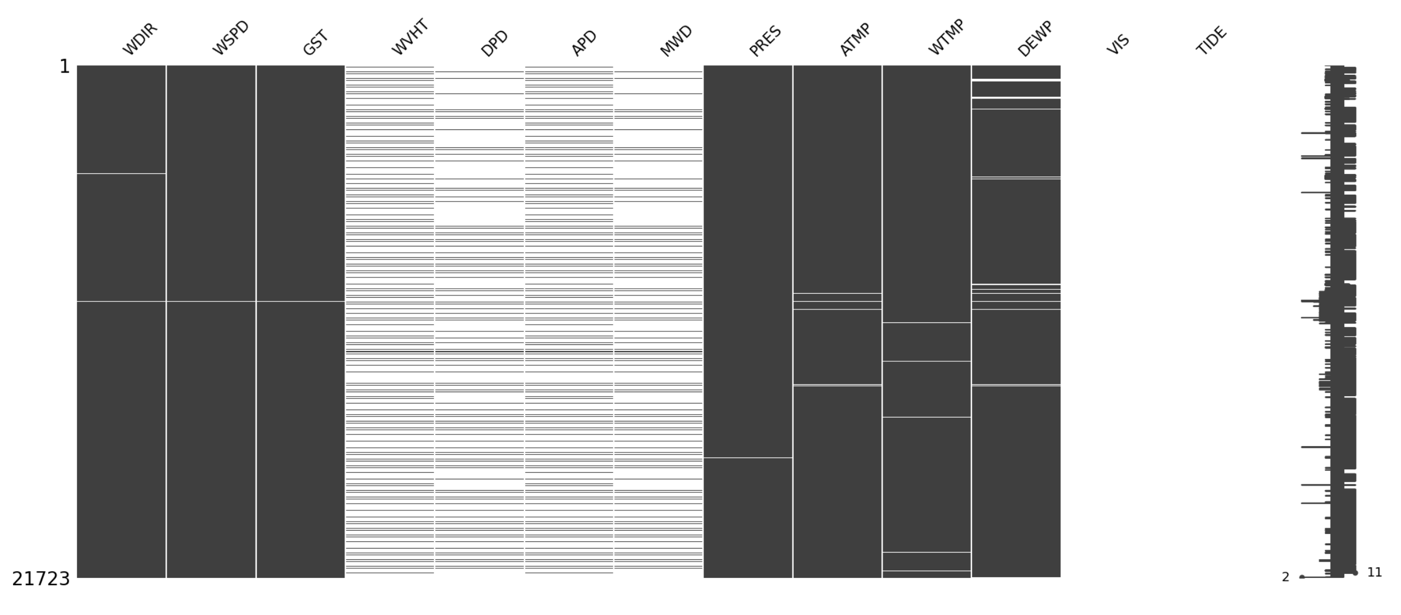
Missing Pattern: from Jun to Oct 2022

Slide 16
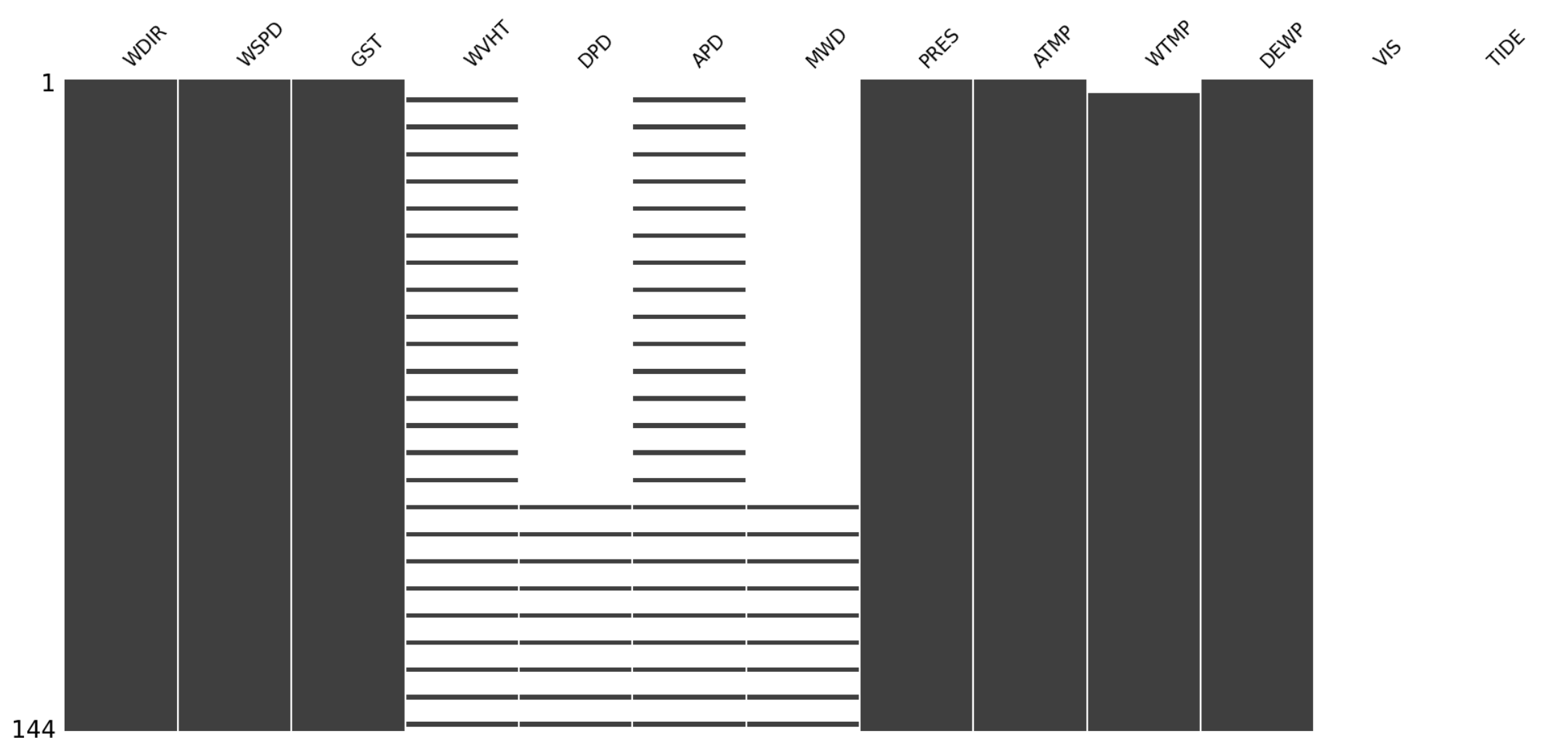
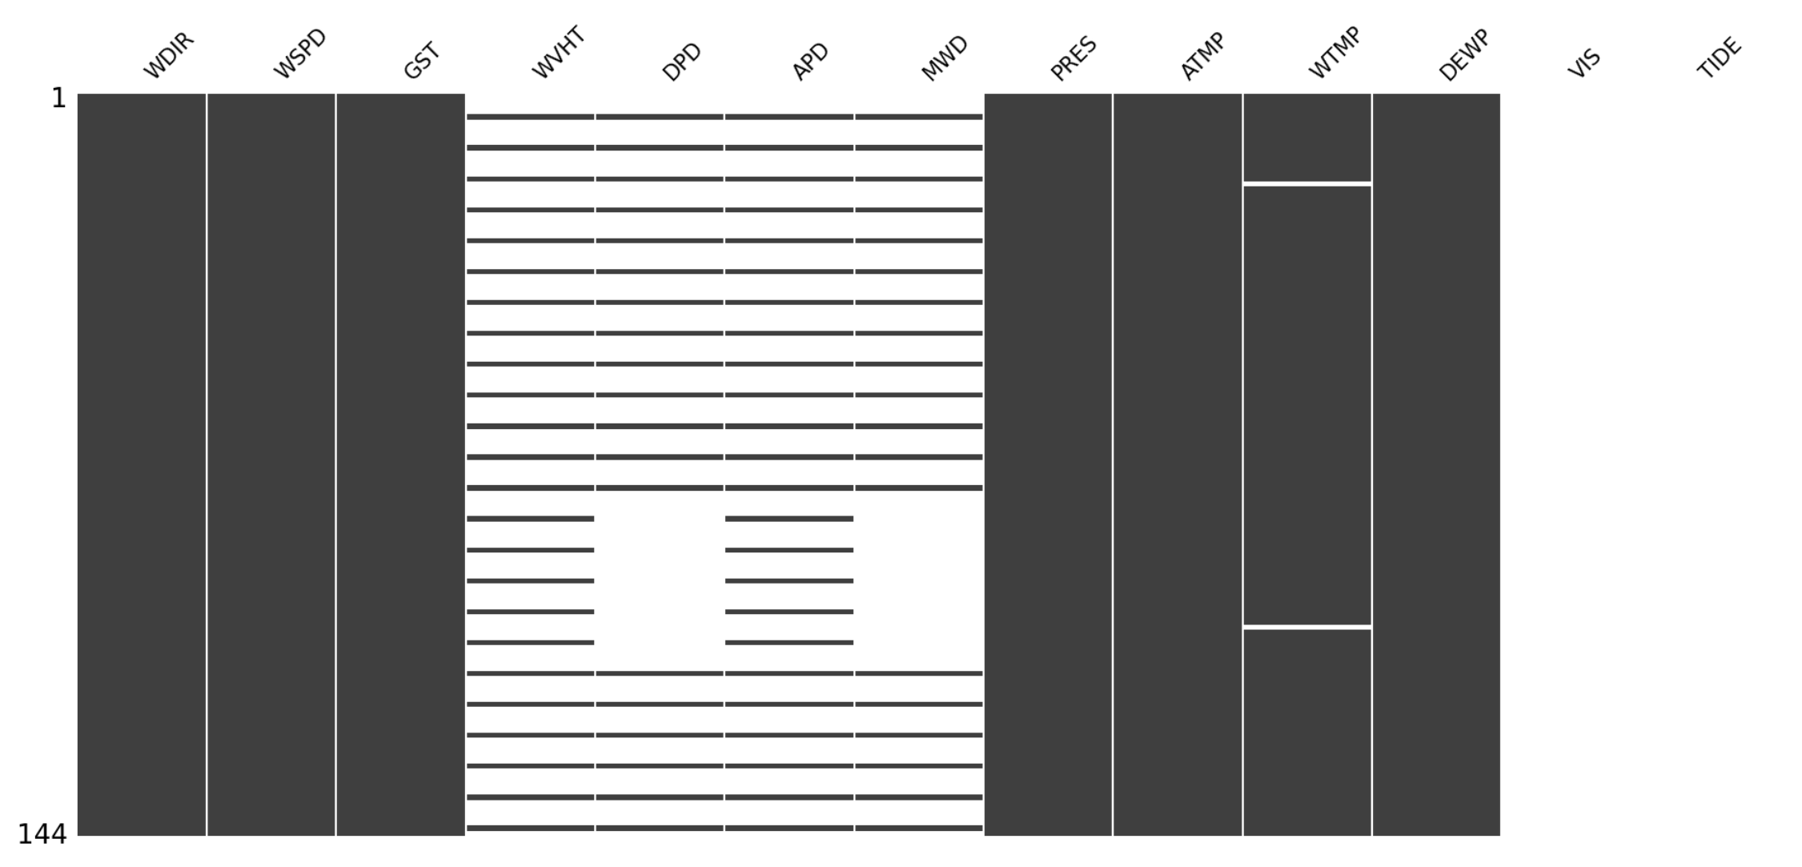
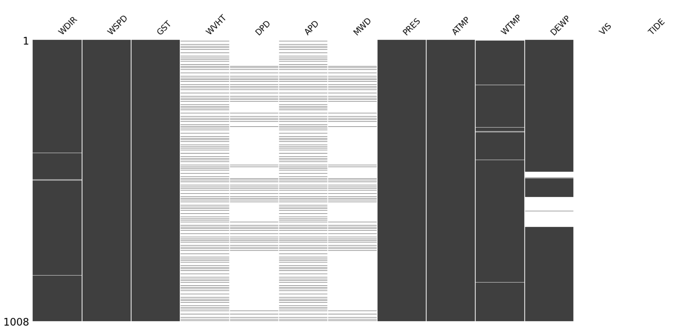
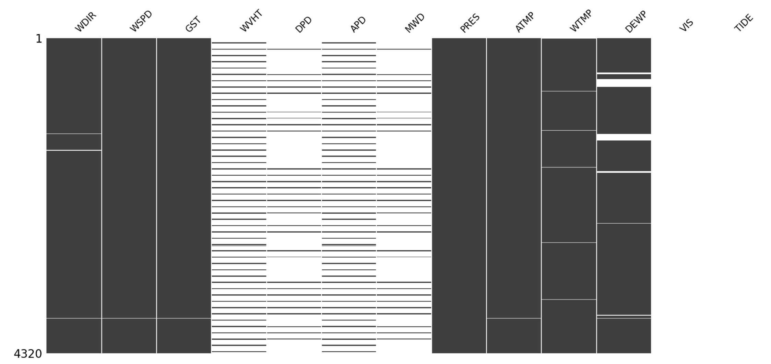
Missing Patterns: by Day, Week, Month
Day 1
Day 2
Week 1
Month 1

Slide 17
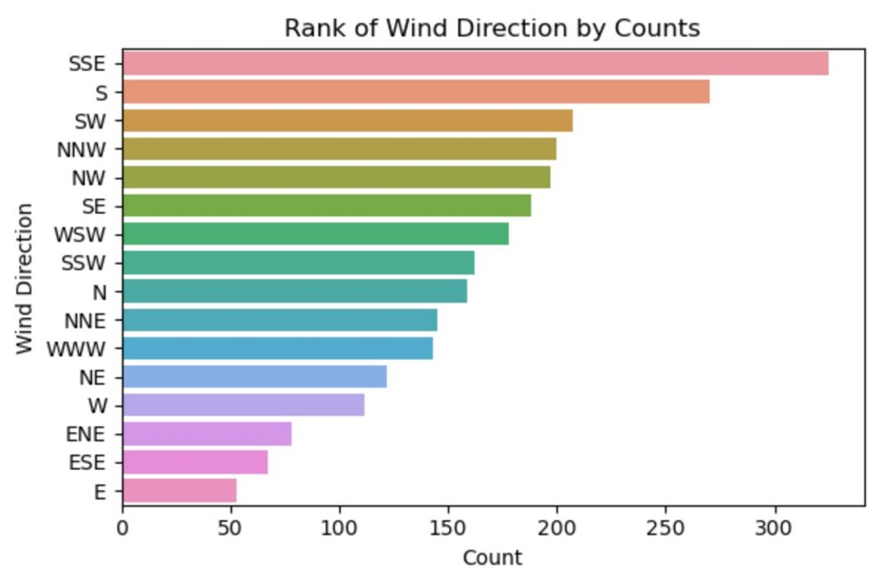
After Thursday Jan 26 Technical meeting
Wind Direction Frequency Distribution 1
Sub-dataset with WVHT and APD: 2614 rows (5% missing)

Slide 18
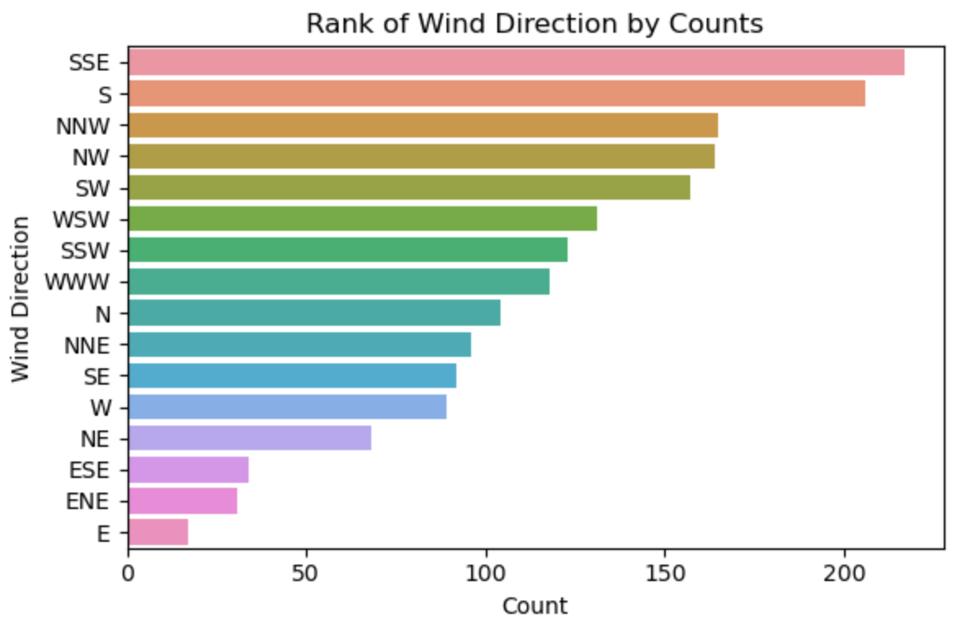
After Thursday Jan 26 Technical meeting
Wind Direction Frequency Distribution 2
Sub-dataset with DPD and MWD :
1819 rows (34% missing)

Slide 19
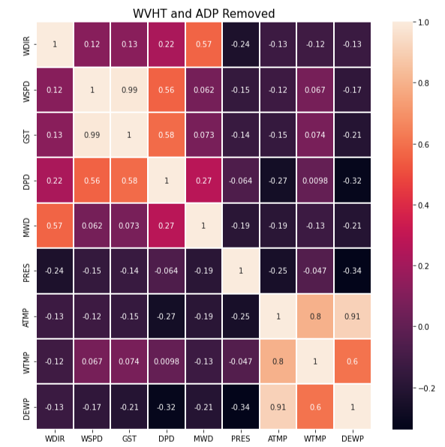
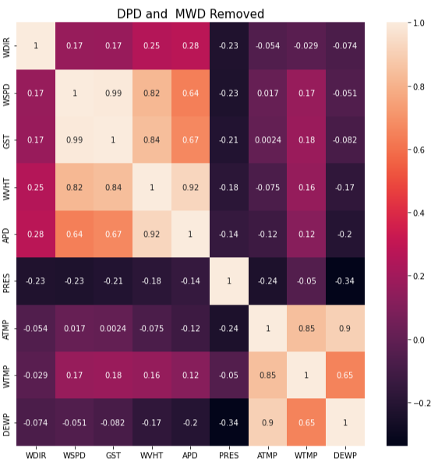
Correlation between variables on Public Data

Slide 20
Implementation Plan
Current Status: On track
Reuirement Phase
Data Cleaning and Analysis Phase
Development and Testing Phase
Release Phase
December 6th, 2022
January 13th , 2023
January 13th , 2023
April 3rd, 2023
Acceptance of Project Charter
Clean given data set
Resample merged dataset
January 26th, 2023
Handover of the Deliverables Phase
Time series visualizations
Model development
Model validation
November 30th, 2022
January 12th, 2023
January 16th, 2023
January 26th, 2023
March 30th, 2023
Prepare Project Charter and MRP Proposal
Retrieve public and
Client dataset
Merge public data with given data
Clean merged dataset
Create training and testing split
Model testing
Final report
Documentation/preparation
April 5th, 2023
Project Close-Out Phase
Who is in charge: | Cassandra | Ruwindhu | Yi-Chen | Whole Team

Slide 21
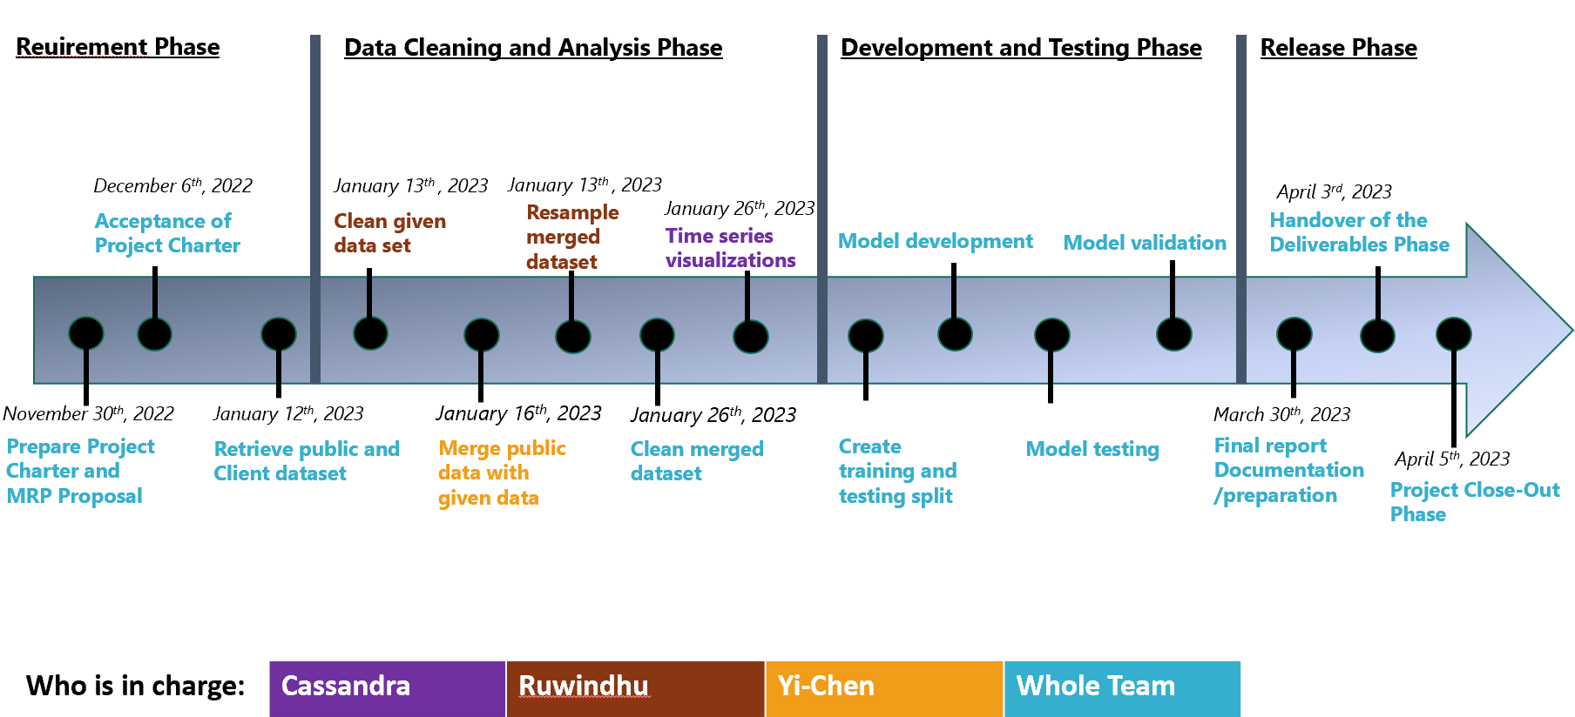

Where we currently are
Data Cleaning and Analysis Phase

Slide 22
Where we hope to be by the end of February
Development and Testing Phase
Create training and testing split
Model development
Process of model testing and validation

Slide 23

Next steps
Creating a test machine learning model using one of the merged datasets (Performed as a test run without much optimization)
Resampling of merged data
Creating training and test splits (Train-Test Spilt Optimization)
Data Augmentation
Winstead (n.d.)
Notes:
Winstead, Tara (n.d.) Close Up Shot Of Planner. Accessed on January 18th, 2023 from https://www.pexels.com/photo/close-up-shot-of-planner-6690932/

Slide 24
Our questions
Drowning Data information
February month update: is your schedule more available Feb 20 – 23 or March 7-10?
Winstead (n.d.)
Notes:
Winstead, Tara (n.d.) Close Up Shot Of Planner. Accessed on January 18th, 2023 from https://www.pexels.com/photo/close-up-shot-of-planner-6690932/

Slide 25

Thank you!
Questions?
Leloo (n.d.)
Notes:
Image: Leloo, The first (2022) https://www.pexels.com/photo/question-marks-on-paper-crafts-5428833/

